Slide 2


PISA 2012
Canadian Results

Slide 3

PISA 2012 by the numbers
65 countries and economies
Over 480,000 15-year-old students
34 OECD countries
47 languages

Slide 4
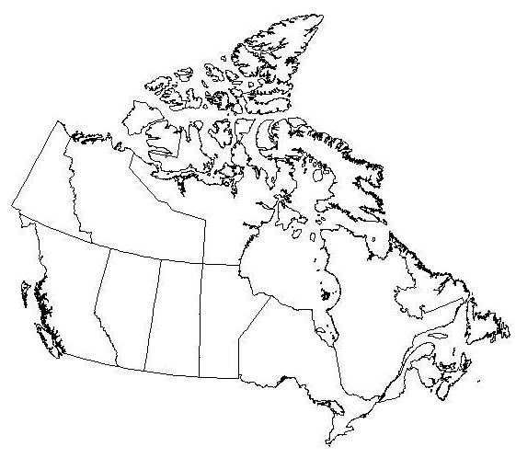
PISA 2012 in Canada
Over 21,000 15-year-old students from over 900 schools
Partnership between CMEC,ESDC and STC
Administered in English and French
10 provinces

Slide 5
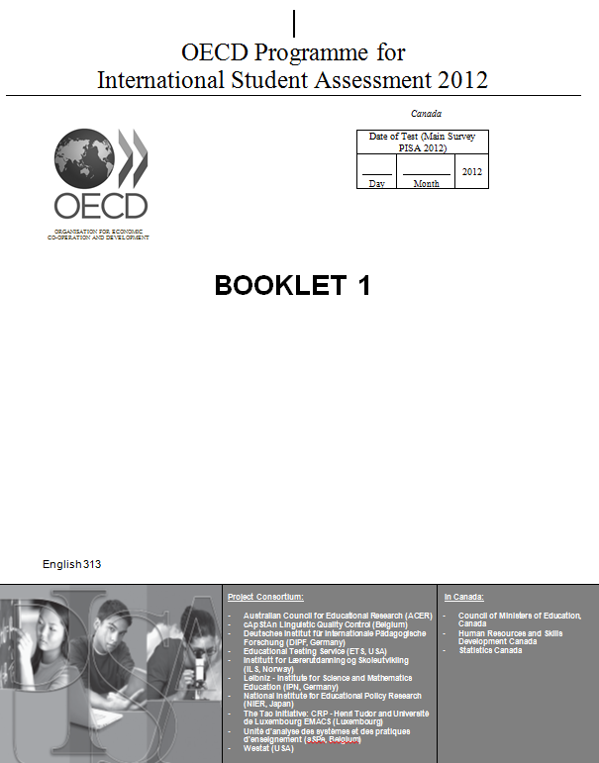
What is in a PISA test?
For all students
For a subset of students
2-hour paper-based test
1-hour computer-based test
Major Domain:
Mathematics
Additional Domains:
Mathematics
Digital reading
Problem solving
Minor Domains:
Reading
Science
30-minute Background Questionnaire

Slide 6
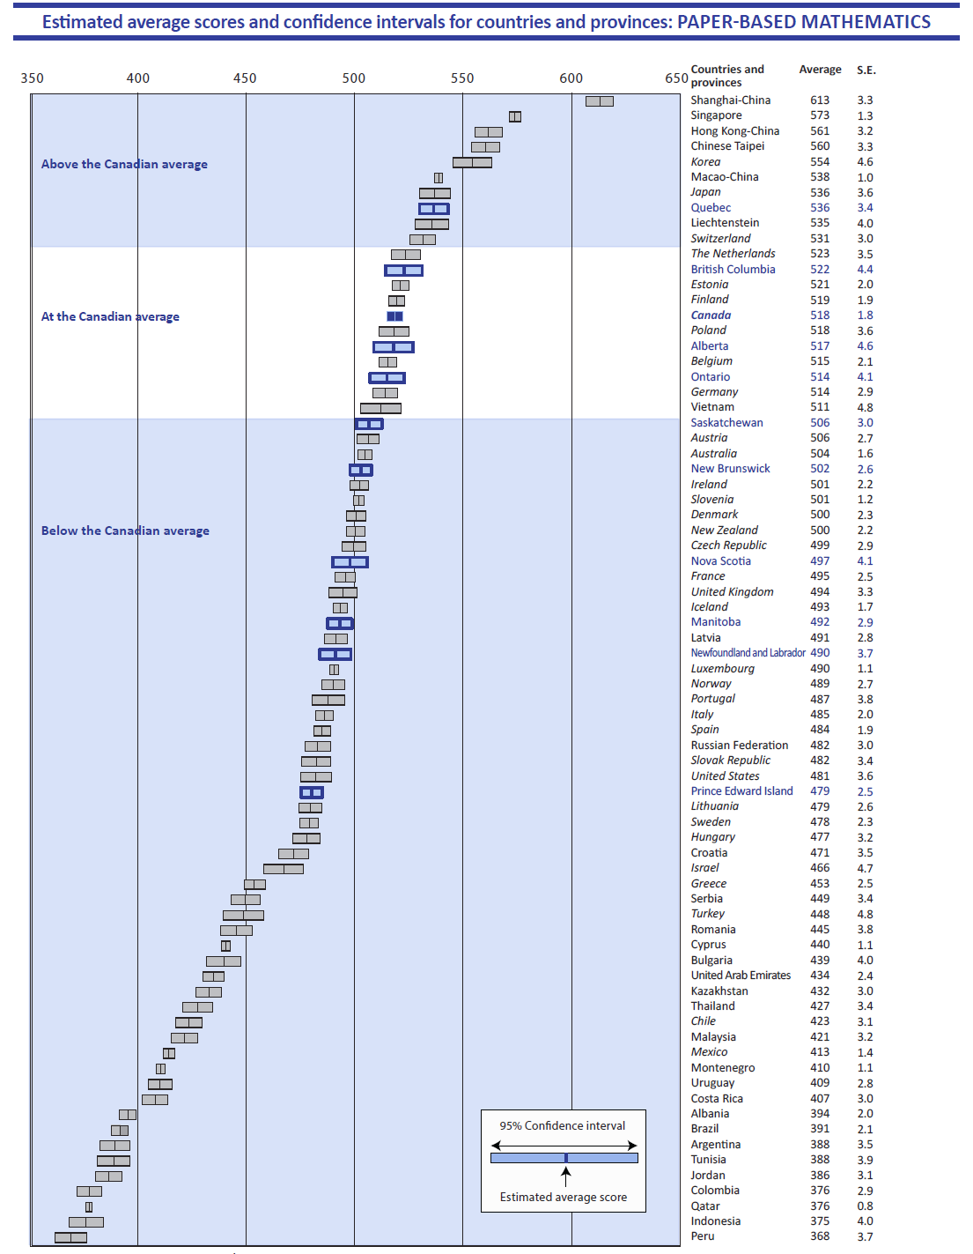
Canadian students continue to perform well in a global context.
Italics = OECD country

Slide 7
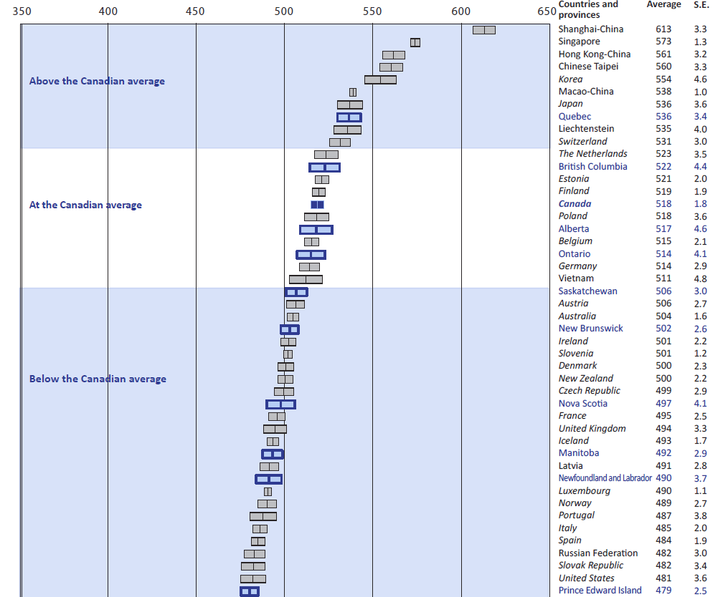
Canadian students continue to perform well in a global context.
Italics = OECD country

Slide 8
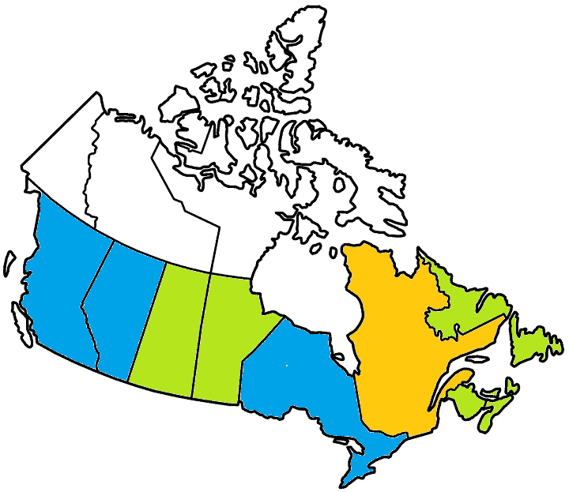
In Canada, there are variations between provinces in mathematics.
Above Canadian average
  Quebec
At the Canadian average
  British Columbia
  Alberta
  Ontario
Below the Canadian average
  Saskatchewan
  Manitoba
  New Brunswick
  Nova Scotia
  Prince Edward Island
  Newfoundland and Labrador

Slide 9
Canadian students continue to perform well in reading ...
Italics = OECD country

Slide 10
Canadian students continue to perform well in reading ...
Italics = OECD country

Slide 11

… and in science.
Italics = OECD country

Slide 12
… and in science.
Italics = OECD country

Slide 13
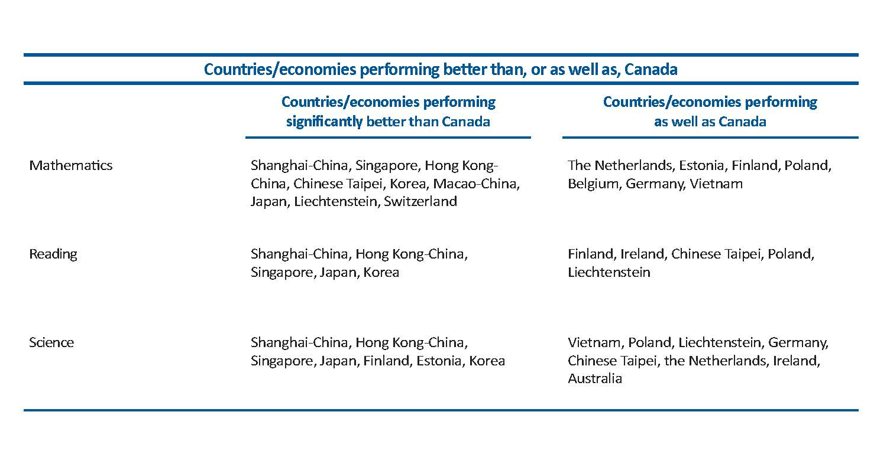
Nine countries achieved higher results than Canada in mathematics, five in reading, and seven in science.

Slide 14
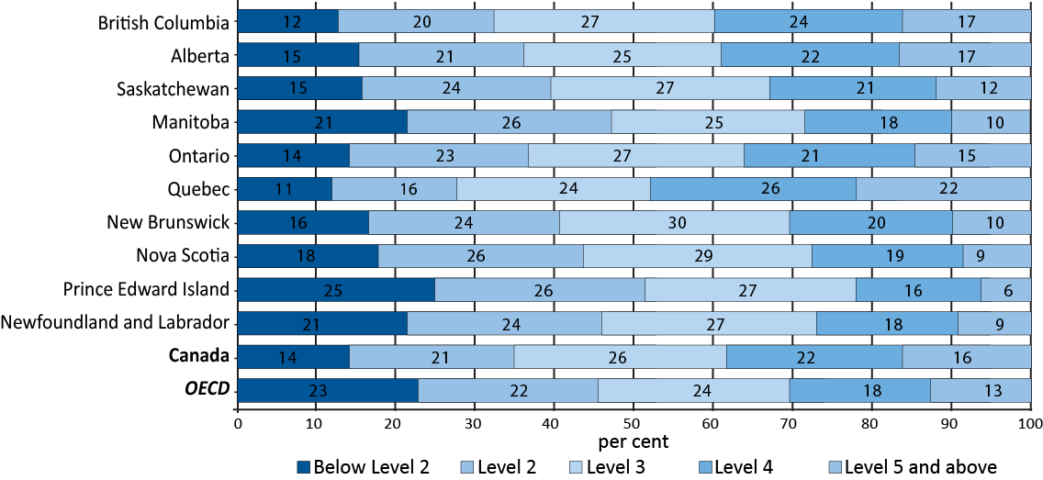
Over 85% of Canadian students reached the baseline Level 2 or above in mathematics…
Distribution of students by proficiency level on the overall mathematics scale, Canada, provinces, and OECD

Slide 15
… while over 16% of Canadian students reached the highest levels of performance.
Distribution of students by proficiency level on the overall mathematics scale, Canada, provinces, and OECD

Slide 16
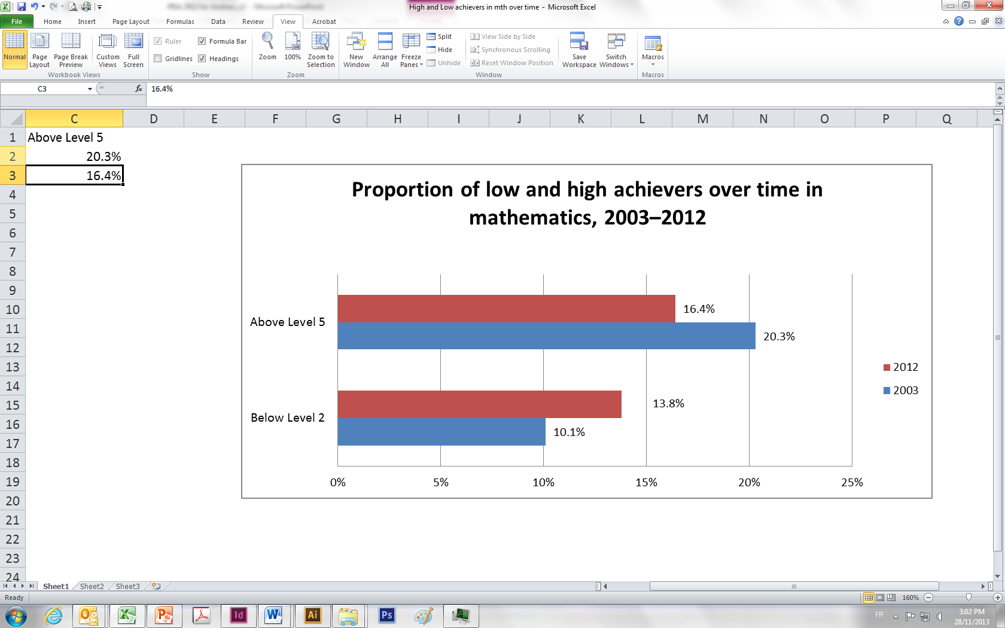
In Canada, the proportion of low achievers has increased over time, while the proportion of high achievers has decreased.

Slide 17
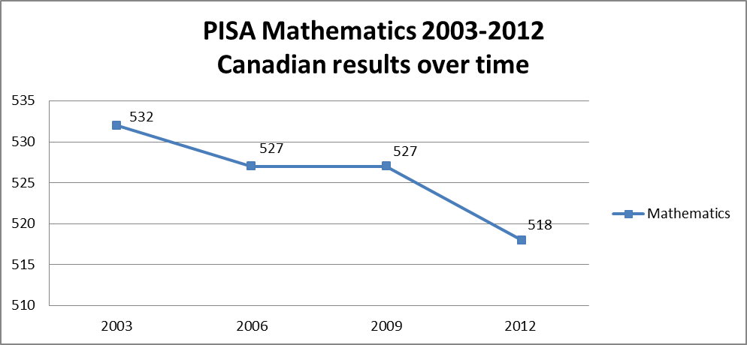
Over the past nine years, Canadian scores in mathematics have declined in all provinces except Quebec and Saskatchewan…

Slide 18
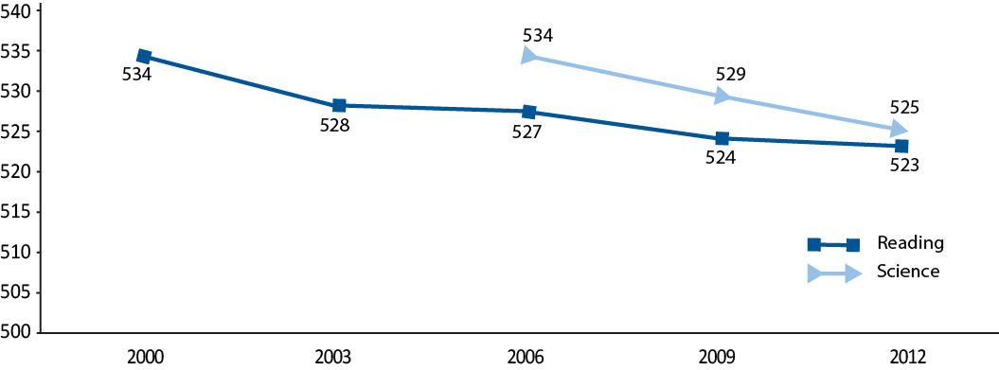
… while Canada’s overall performance in reading has remained stable over time, and performance in science has decreased.
Canadian results over time, 2000–2012
Reading and Science

Slide 19
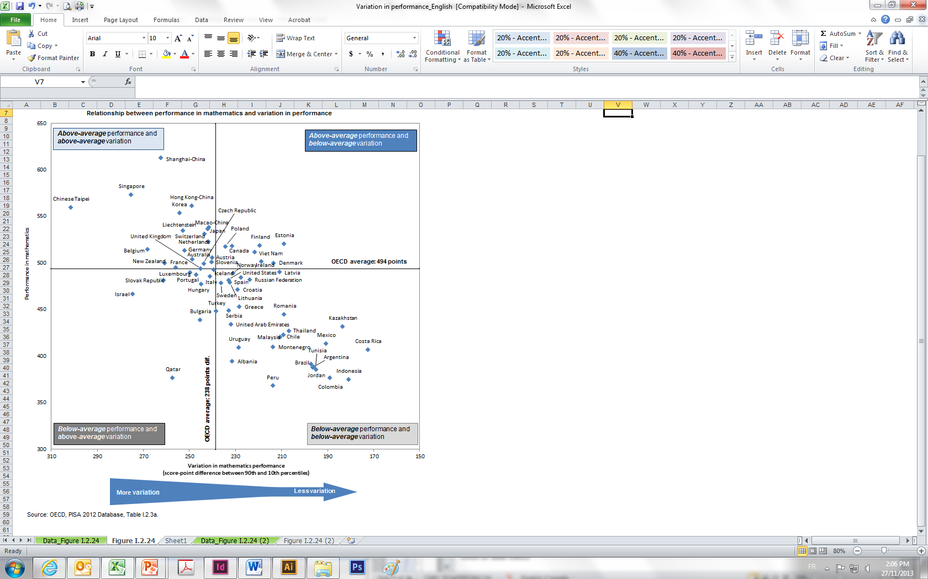
Canadian results in mathematics are characterized by relatively high levels of achievement and equity.

Slide 20
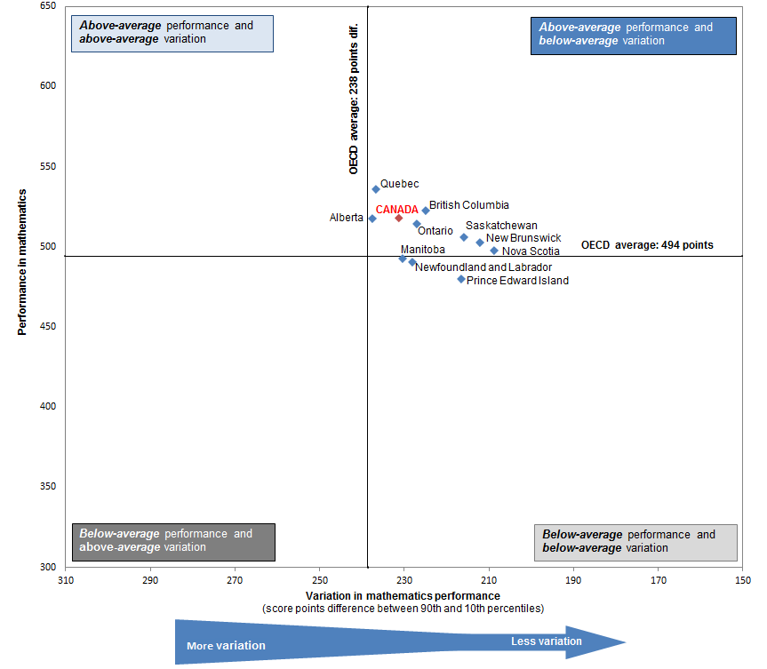
Provincial results in mathematics are also characterized by relatively high levels of achievement and equity.

Slide 21
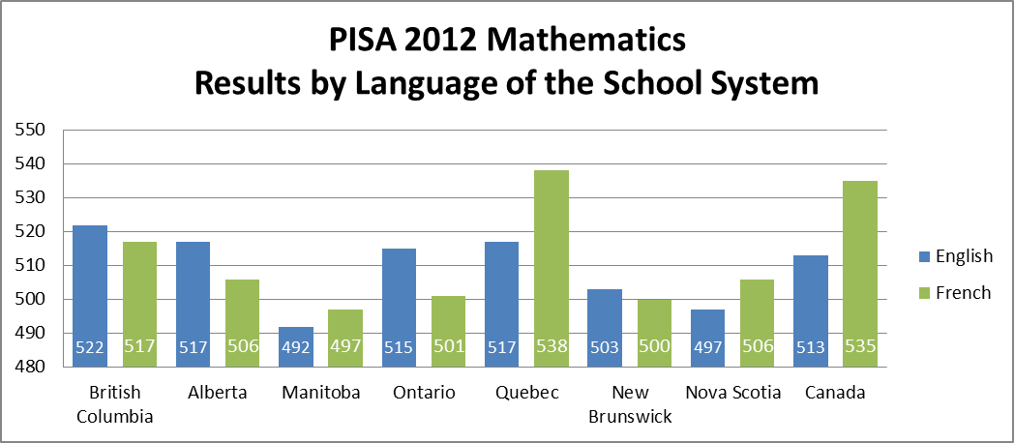
Across Canada, mathematics results show some differences by language of the school system.

Slide 22
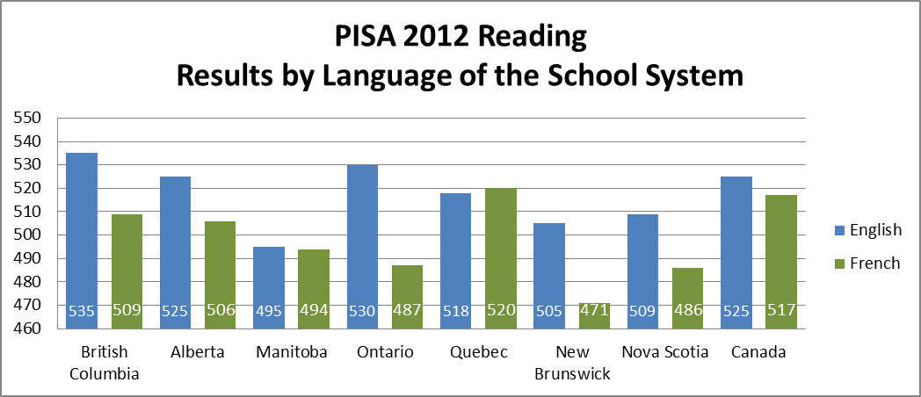
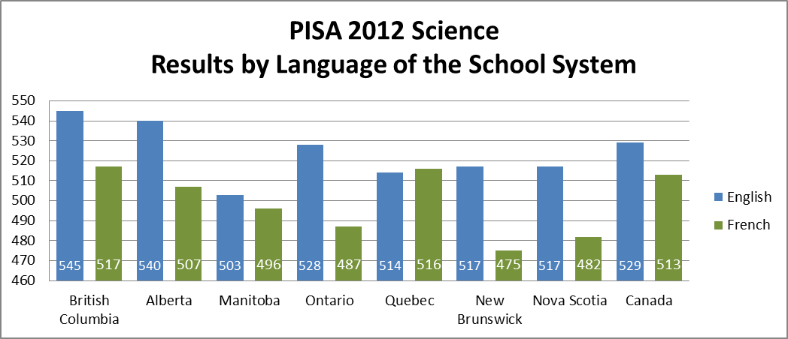
There are large differences in reading and science achievement by language of the school system in most provinces.

Slide 23
Males perform better than females in mathematics …
… but the gender gap in reading in favour of females is larger and persistent, while there is no significant difference in science.
10 points
17 points
35 points
21 points
3 points

